Slide 1
Computational Physics (Lecture 16)
PHY4061

Slide 2
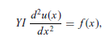
Example: a person is sitting at the middle of a long bench supported at both ends.
Assume that the length of the bench is L.
If we want to know the displacement of the bench at every point, we can establish the equation for the curvature at different locations from Newton’s equation for each tiny slice of the bench.
where u(x) is the curvature (that is, the inverse of the effective radius of the curve
at x), Y is Young’s modulus of the bench, I = t³ w/3 is a geometric constant, with
t being the thickness and w the width of the bench, and f (x) is the force density
on the bench.
Because both ends are fixed, the curvatures there are taken to be
zero: that is, u(0) = u(L) = 0.

Slide 3
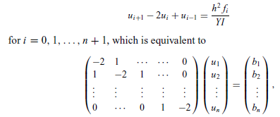
If we discretize the equation with evenly spaced intervals, that is, x₀ = 0, x₁ = h, . . . , x_{n+1} = L, via the three-point formula for the second-order derivative, we have
with u₀ = u_{n+1} = 0, as required by the boundary condition, and bi = h² fi /YI .
We can easily solve the problem with the Gaussian elimination scheme or the
LU decomposition scheme

Slide 4
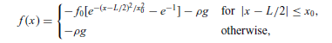
ei = ci = 1 and di = −2. Assume that the force distribution on the bench is given by
with f0 = 200 N/m and x0 = 0.25 m, and that the bench has a length of 3.0 m,
a width of 0.20 m, a thickness of 0.030 m, a linear density of ρ = 3.0 kg/m, and
a Young’s modulus of 1.0 × 10⁹ N/m2. Here g = 9.80 m/s² is the magnitude of the gravitational acceleration

Slide 5
// A program to solve the problem of a person sitting
// on a bench as described in the text.
import java.lang.*;
public class Bench {
final static int n = 99, m = 2;
public static void main(String argv[]) {
double d[] = new double[n];
double b[] = new double[n];
double c[] = new double[n];
double l = 3, l2 = l/2, h = l/(n+1), h2 = h*h;
double x0 = 0.25, x2 = x0*x0, e0 = 1/Math.E;
double rho = 3, g = 9.8, f0 = 200;
double y = 1e9*Math.pow(0.03,3)*0.2/3;
// Evaluate the coefficient matrix elements
for (int i=0; i<n; ++i) {
d[i] = -2;
c[i] = 1;
b[i] = -rho*g;
double x = h*(i+1)-l2;
if (Math.abs(x) < x0)
b[i] -= f0*(Math.exp(-x*x/x2)-e0);
b[i] *= h2/y;
}
// Obtain the solution of the curverture of the bench
double u[] = tridiagonalLinearEq(d, c, c, b);
// Output the result in every m time steps
double x = h;
double mh = m*h;
for (int i=0; i<n; i+=m) {
System.out.println(x + " " + 100*u[i]);
x += mh;
}
}
// Method to solve the tridiagonal linear equation set.
public static double[] tridiagonalLinearEq(double d[],
double e[], double c[], double b[]) {...}
}

Slide 6
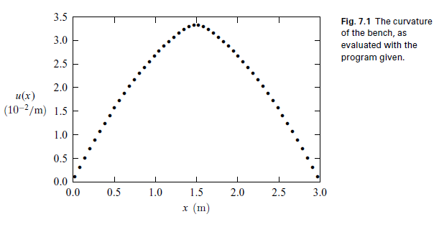
The numerical result for the curvature of the bench calculated with the above
program is illustrated here. Under these realistic parameters, the bench
does not deviate from the original position very much. Even at the middle of the
bench, the effective radius for the curve is still about 30 m.

Slide 7
When the equation is discretized into a difference equation, it becomes extremely simple with a symmetric, tridiagonal coefficient matrix.
In general, all one-dimensional problems with the same mathematical structure can be solved in the same fashion, such as the one-dimensional Poisson equation or the stationary one-dimensional diffusion equation.

Slide 8
If we split the coefficient matrix among the coordinates correctly, we can still preserve its tridiagonal nature, at least, in each step along each coordinate direction.
As long as the coefficient matrix is tridiagonal, we can use the simple LU decomposition to obtain the solution of the linear equation set.
Sometimes we may also need to solve the linear problem with the full matrix that is no longer tridiagonal. We can just apply the methods we learned in the matrix chapter to solve them.
Such as household algorithm.

Slide 9
The relaxation method
a functional can be constructed for the purpose of discretizing a differential equation.
The procedure for reaching the differential equation is to optimize the functional.
In most cases, the optimization is equivalent to the minimization of the functional.
A numerical scheme can therefore be devised to find the numerical solution iteratively, as long as the functional associated with the equation does not increase with each new iteration.

Slide 10
The solution of the differential equation is obtained when the functional no longer changes.
This numerical scheme, formally known as the relaxation method, is extremely powerful for solving elliptic equations, including the Poisson equation, the stationary diffusion equation, and the spatial part of the wave equation after the separation of variables.

Slide 11
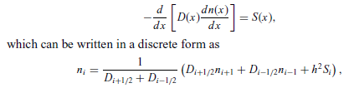
the stationary one-dimensional diffusion equation

Slide 12
the basic idea of the relaxation method: a guessed solution that satisfies the required boundary condition is gradually modified to satisfy the difference equation within the given tolerance.
So the key is to establish an updating scheme that can modify the guessed solution gradually toward the correct direction, namely, the direction with the functional minimized.

Slide 13
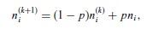
the following updating scheme
where n^{(k)}_{i} is the solution of the kth iteration at the ith lattice point; n_{i} is given
from Eq. (7.69) with the terms on the right-hand side calculated under n^{(k)} _{i} .
p is an adjustable parameter restricted in the region p ∈ [0, 2].
Reexamine the bench problem.
D(x) = 1 and S(x) = −f (x)/(Y I).

Slide 14
// A program to solve the problem of a person sitting
// on a bench with the relaxation scheme.
import java.lang.*;
public class Bench2 {
final static int n = 100, m = 2;
public static void main(String argv[]) {
double u[] = new double[n+1];
double d[] = new double[n+1];
double s[] = new double[n+1];
double l = 3, l2 = l/2, h = l/n, h2 = h*h;
double x0 = 0.25, x2 = x0*x0, e0 = 1/Math.E;
double x = 0, rho = 3, g = 9.8, f0 = 200;
double y = 1e9*Math.pow(0.03,3)*0.2/3;
double u0 = 0.032, p = 1.5, del =1e-3;
int nmax = 100;
// Evaluate the source in the equation
for (int i=0; i<=n; ++i) {
s[i] = rho*g;
x = h*i-l2;
if (Math.abs(x) < x0)
s[i] += f0*(Math.exp(-x*x/x2)-e0);
s[i] *= h2/y;
}
for (int i=1; i<n; ++i) {
x = Math.PI*h*i/l;
u[i] = u0*Math.sin(x);
d[i] = 1;
}
d[0] = d[n] = 1;
relax(u, d, s, p, del, nmax);
// Output the result in every m time step
x = 0;
double mh = m*h;
for (int i=0; i<n; i+=m) {
System.out.println(x + " " + 100*u[i]);
x += mh;
}
}
// Method to complete one step of relaxation.
public static void relax(double u[], double d[],
double s[], double p, double del, int nmax) {
int n = u.length-1;
double q = 1-p, fi = 0;
double du = 2*del;
int k = 0;

Slide 15
while ((du>del) && (k<nmax)) {
du = 0;
for (int i=1; i<n; ++i) {
fi = u[i];
u[i] = p*u[i]
+q*((d[i+1]+d[i])*u[i+1]
+(d[i]+d[i-1])*u[i-1]+2*s[i])/(4*d[i]);
fi = u[i]-fi;
du += fi*fi;
}
du = Math.sqrt(du/n);
k++;
}
if (k==nmax) System.out.println("Convergence not" +
" found after " + nmax + " iterations");
}
}

Slide 16
Note that in the above method we have used the updated u_{i−1} on the right hand side of the relaxation scheme, which is usually more efficient but less stable!
We have also used D _{(i−1/2)}≈(D_{i} + D _{(i−1)})/2, D_{(i+1/2)} ≈ (D_{i} + D_{(i+1)})/2, and D_{(i+1/2)} + D_{(i−1/2)} ≈ 2D_{i}
The multiplication of S(x) by h² is done outside the method to keep the scheme more efficient.
In general, the solution with the LU decomposition is faster and more stable than the solution with the relaxation method for the bench problem.
But the situation reverses in the case of a higher dimensional system.

Slide 17
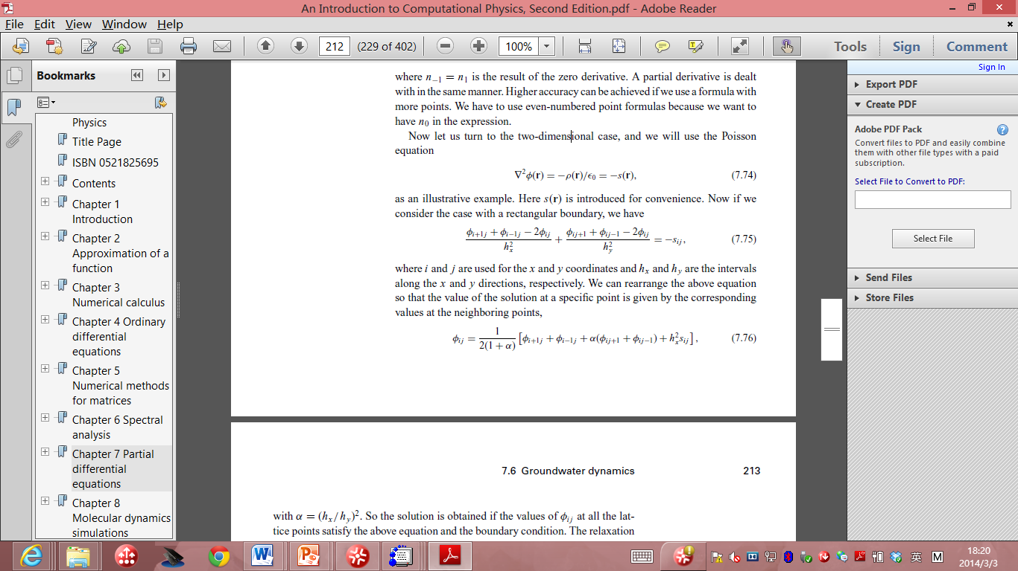
Now let us turn to the two-dimensional case, and we will use the Poisson equation:
if we consider the case with a rectangular boundary, we have
where i and j are used for the x and y coordinates and hx and hy are the intervals
along the x and y directions, respectively.

Slide 18
We can rearrange the above equation so that the value of the solution at a specific point is given by the corresponding values at the neighboring points:
with α = (hx/hy )².

Slide 19
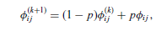
The solution is obtained if the values of φi j at all the lattice points satisfy the above equation and the boundary condition.
We first guess a solution that satisfies the boundary condition.
Then we can update or improve the guessed solution with
where p is an adjustable parameter close to 1. Here φ^{(k)}_{i j} is the result of the
kth iteration, and φ_{i j} is obtained with φ^{(k)}_{i j} used on the right-hand side of the equation on the last page.

Slide 20
The second part of the above equation can be viewed as the correction to the solution, because it is obtained through the differential equation.
The choice of p determines the speed of convergence.
If p is selected outside the allowed range by the specific geometry and discretization,
the algorithm will be unstable.

Slide 21
The optimized p is somewhere between 0 and 2.
In practice, we can find the optimized p easily by just running the program for a few iterations, say, ten, with different values of p.
The convergence can be analyzed easily with the result from iterations of each choice of p.
Mathematically, one can place an upper limit on p but in practice, this is not really necessary, because it is much easier to test the choice of p numerically.

Slide 22
Initial-value problems
Typical initial-value problems:
time-dependent diffusion equation,
the time-dependent wave equation
Some are non-linear:
the equation for a stretched elastic string
the Navier–Stokes equation in fluid dynamics.
apply the Fourier transform for the time variable of the equation to reduce it to a stationary equation
which can be solved by the relaxation method
The time dependence can be obtained
with an inverse Fourier transform
after the solution of the corresponding stationary case is obtained.

Slide 23
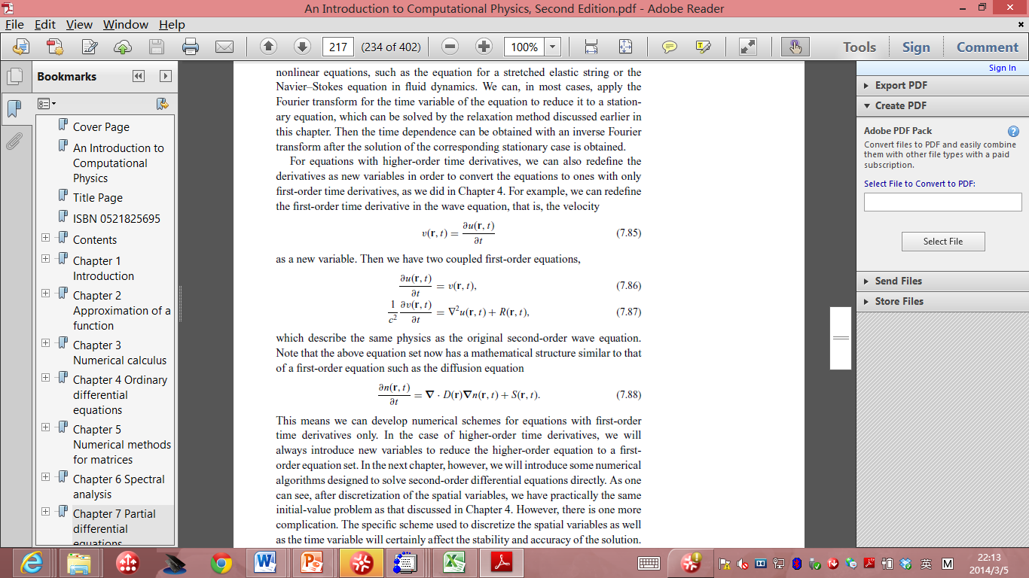
For equations with higher-order time derivatives
redefine the derivatives and convert the equations to ones with only first-order time derivatives.
For example, we can redefine the first-order time derivative in the wave equation, the velocity:

Slide 24
Then we have two coupled first-order equations:
the above equation set now is similar to a first-order equation such as the diffusion equation:

Slide 25
This means we can develop numerical schemes for equations with first-order time derivatives only.
In the case of higher-order time derivatives, we will always introduce new variables to reduce the higher-order equation to a first order equation set.
After discretization of the spatial variables, we have practically the same initial-value problem as that discussed in ODE Chapter.
However, there is one more complication.
The specific scheme used to discretize the spatial variables as well as the time variable will certainly affect the stability and accuracy of the solution.

Slide 26
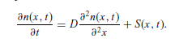
To analyze the stability of the problem, let us first consider the one dimensional diffusion equation:
If we discretize
the first-order time derivative by means of the two-point formula with an interval τ
the second-order spatial derivative by means of the three-point formula with an interval h, we obtain a difference equation
n_{i} (t + τ ) = n_{i} (t) + γ [n_{i+1} (t) + n_{i−1} (t) − 2n_{i} (t)] + τ S_{i} (t),
which is the result of the Euler method

Slide 27
Here γ = Dτ/h² is a measure of the relative sizes between the space and the time intervals.
Note that we have used n_{i} (t) =n(x_{i} , t) for notational convenience.
So the problem is solved if we know the initial value n(x, 0) and the source S(x, t).
However, this algorithm is unstable if γ is significantly larger than 1/2.

Slide 28
A better scheme is the Crank–Nicolson method,
which modifies the Euler method by using the average of the second-order spatial derivative and the source at t and t + τ on the right-hand side of the equation,
resulting in: n_{i} (t + τ ) = n_{i} (t) + 1/2{[H_{i} n_{i} (t) + τ S_{i} (t)] + [H_{i} n_{i} (t + τ ) + τ S_{i} (t + τ )]},
where we have used H_{i} n_{i} (t) = γ [n_{i+1} (t) + n_{i-1} (t) − 2n_{i} (t)] to simplify the notation.
The implicit iterative scheme can be rewritten into the form:
(2 − H_{i} )n_{i} (t + τ ) = (2 + H_{i} ) n_{i} (t) + τ [S_{i} (t) + S_{i} (t + τ )].
a linear equation set with a tridiagonal coefficient matrix, which can easily be solved
the algorithm is stable for any γ and converges as h → 0, and that the error in the solution is on the order of h²
One question: How about high dimensional problems?

Slide 29
However, the above tridiagonal matrix does not hold if the system is in a higher dimensional space.
There are two ways to deal with this problem in practice.
We can discretize the equation in the same manner and then solve the resulting linear equation set with some other methods, such as the Gaussian elimination scheme or a general LU decomposition scheme for a full matrix.
A more practical approach is to deal with each spatial coordinate separately.

Slide 30
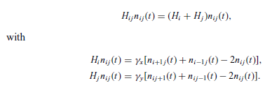
For example, if we are dealing with the two-dimensional diffusion equation, we have

Slide 31
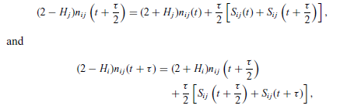
Here γ_{x} = Dτ/h_{x} ² and γ_{y} = Dτ/h_{y} ².
The decomposition of Hi j into H_{i} and H_{j} can be used to take one half of each time step along the x direction and the other half along the y direction with

Slide 32
in each of the above two steps, we have a tridiagonal coefficient matrix.
We still have to be careful in using the Peaceman–Rachford algorithm.
the convergence in the Peaceman–Rachford algorithm can sometimes be very slow in practice.

Slide 33
For a few more examples
Temperature field of a nuclear waste rod problem
Ground water dynamics
Just read Tao Pang’s book if you are interested in them.

Slide 34
HW 3 (no need to do all questions)
3 options:
Finish Q1 and Q2,
Finish Q3,
Finish Q4
Suppose in a parallel world where the air resistance force is proportional to V ^{7/5}. Rewrite the motor cyclist program in C or fortran to calculate this problem show in the lecture notes 13(Assume all the parameters are the same). Show the difference between this model and the model shown in the lecture notes.

Slide 35
HW3 A
Setup and run the java code of the relaxation method shown in the lecture notes 16(You can also rewrite it in C/C++ or fortran if you don’t know how to run Java or you enjoy programming), test 10 different p values and the convergence speed, report the best choice of p values in your code. (Note that I am not asking you to provide the optimum of p among all possible choices of p.)

Slide 36
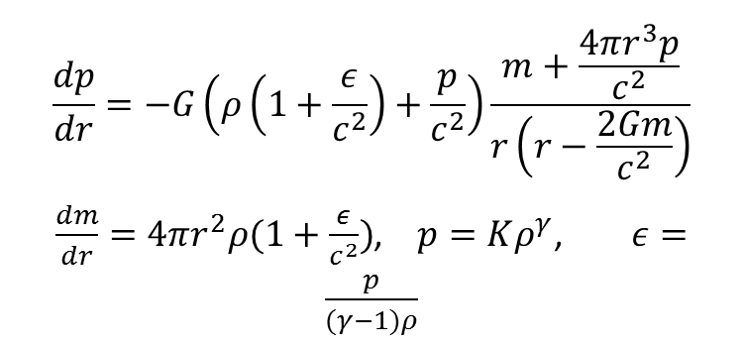
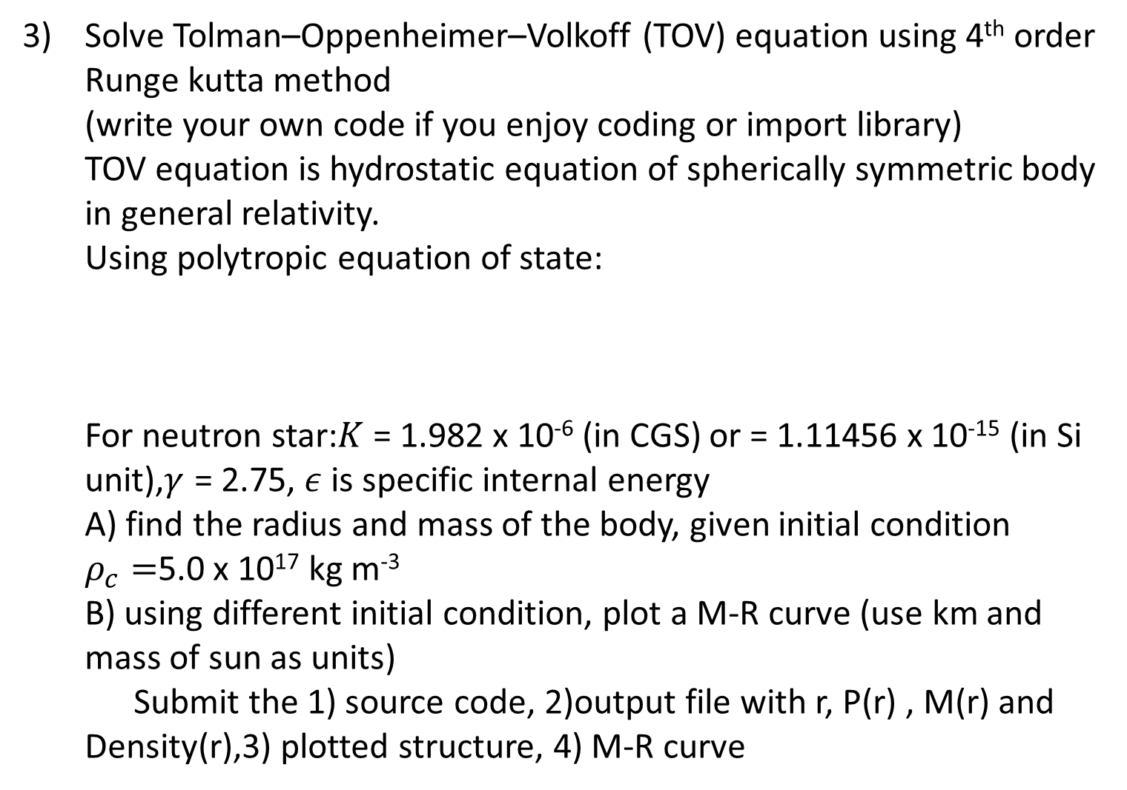
HW 3 B
Solve Tolman–Oppenheimer–Volkoff (TOV) equation using 4th order Runge kutta method (write your own code if you enjoy coding or import library) TOV equation is hydrostatic equation of spherically symmetric body in general relativity. Using polytropic equation of state: For neutron star:$K$ = 1.982 x 10⁻⁶ (in CGS) or = 1.11456 x 10⁻¹⁵ (in Si unit),$γ$ = 2.75, $ε$is specific internal energy A) find the radius and mass of the body, given initial condition $ρ_{c}=$5.0 x 10¹⁷ kg m⁻³ B) using different initial condition, plot a M-R curve (use km and mass of sun as units) Submit the 1) source code, 2)output file with r, P(r) , M(r) and Density(r),3) plotted structure, 4) M-R curve
$$\frac{dp}{dr}=−G\left(ρ\left(1+\frac{ε}{c^{2}}\right)+\frac{p}{c^{2}}\right)\frac{m+\frac{4πr^{3}p}{c^{2}}}{r\left(r−\frac{2Gm}{c^{2}}\right)}$$
$\frac{dm}{dr}=4πr^{2}ρ(1+\frac{ε}{c^{2}})$, $p=Kρ^{γ}$, $ε=\frac{p}{(γ−1)ρ}$

Slide 37
HW3 C
Or 4) Three body simulation using gravitational force Write a code for three body simulation of gravitational force. Implement Euler method and one predictor-corrector algorithm on same initial condition. Calculate the individual kinetic energy, total kinetic energy and total potential energy.
Submit the 1) source code, 2) output .xyz files of trajectory, 3) plots of the KE vs time and PE vs time in two different integration methods you chosen, 4) A small report to explain the difference in energy conservation between the two methods you used

